Slide 1

Classes & Objects

Slide 2

Exam Objectives
Describing and Using Objects and Classes
Declare and instantiate Java objects, and explain objects’ lifecycles (including creation, dereferencing by reassignment, and garbage collection)
• Define the structure of a Java class
• Read or write to object fields

Slide 3
Classes : An Introduction
A class as the name suggests is a category of objects having unique and distinguishable characteristics.
Ex. class of red roses ,class of cars with power steering etc.
In java we use a class to model a real world entity.
Once a class is created we can then create objects of it. This is similar to having a class of Mercedes Benz cars and actually buying a mercedez benz of that class.
Classes in java have member variables and methods.
For example we could create an Employee class and save it using .java extension.

Slide 4
Structure of a class.
Within a class you can have the following :
Instance and static members of different data types
Instance and static methods
Constructors
Object initializers & static initializers
Another class.
An actual instance of the class is called it’s object. Objects are created using the new operator as follows :
Employee employee = new Employee()
This statement creates an object of employee class an assigns it to the employee reference.

Slide 5
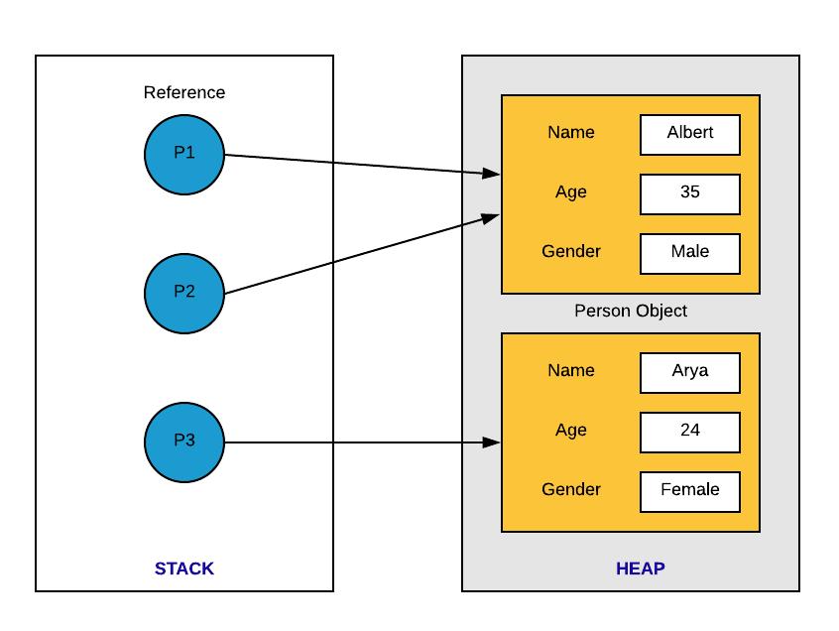
References
An instance of a class is called an object. Objects are created using new operator.
A reference variable is like a pointer to an object of reference type.
All operations on the object happens through the reference variable.
A reference variable is similar to int variable as int variable stores a number and reference variable also stores a number but that number denotes the memory location of the object.
Assigning ‘null’ to a reference variable in java means that , that reference variable does not point to any object.

Slide 6
Static members of Class
Static members of a class are those that belong to the class. Non-static members of the class belong to the instantiated objects of that class. All objects have their own copy of the non-static members of the class.
Static members of the class can be accessed as follows :
<Classname>.<static member>

Slide 7
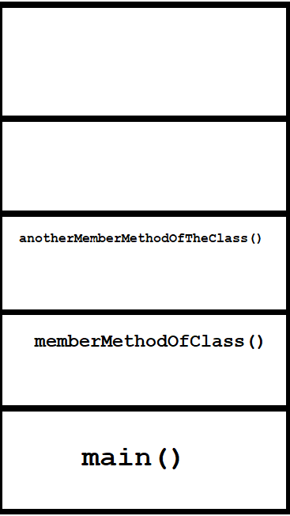
Stack
All programs in java are executed in a thread. A thread is a basic unit of execution. There is a main thread that starts the execution. Each thread has a dedicated stack memory for program execution.
Stack is a data structure which follows Last In First Out (LIFO) order.
Add operation on a stack is referred to as push and remove operation is referred to as pop.
Whenever we call a method ,a new block of memory is allocated on top of the current block in the stack memory. We call this as stack frame. All variables inside the method are allocated space in that stack frame. Once that method call finishes that specific stack frame which was allocated for that method call is popped.
Default stack size is 1MB. We can change this value as needed.

Slide 8
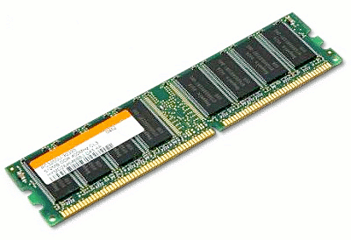
Heap
Heap is used for dynamic allocation of memory.
Objects are always created on the heap memory.
This is a shared memory and is shared by all threads currently executing.
References point to these objects on the heap.

Slide 9
Reference to Object
An instance of a class is called an object. Objects are created using new operator.
A reference variable is like a pointer to an object of reference type.
All operations on the object happens through the reference variable.
A reference variable is similar to int variable as int variable stores a number and reference variable also stores a number but that number denotes the memory location of the object.
Assigning ‘null’ to a reference variable in java means that , that reference variable does not point to any object.

Slide 10
Accessing Object Members
Each object has its own personal copy of all member variables of the class.
In order to access the members of the class we make use of dot(.) operator.
Member Variable access :
<referenceVariable>.<memberVariable>
Member method access :
<referenceVariable>.<memberMethod>

Slide 11
Others
The “this” pointer is available for use within the class of the current object. In order to reduce ambiguity in accessing the instance member of the class “this” pointer is used.

Slide 12

Questions ??
a b c

